Slide 1
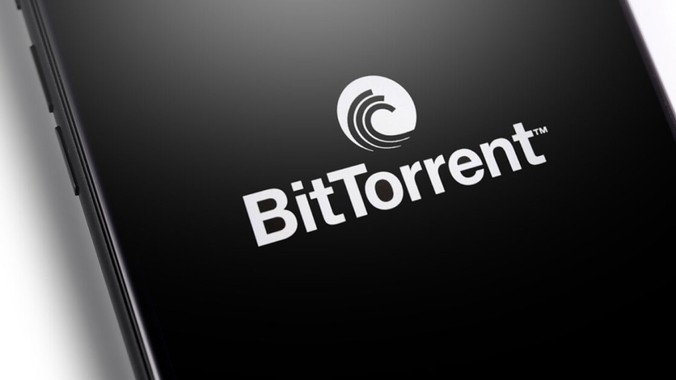
Protocol Name :BitTorrent

Slide 2


PRESENTER
Yesha Patel
Student number: 000932365
Course: computer system technician – software support

Slide 3

Bit Torrent protocol is a fascinating peer-to-peer (P2P) file sharing mechanism.
Overview of BitTorrent Protocol:
The BitTorrent protocol is designed for efficient distribution of large files across a network without relying on a central server.
Peers (users) collaborate by downloading and uploading parts of a file from one another, creating a dynamic network known as a swarm.
How BitTorrent works:
A torrent file is also called a meta info file. It act as a map for the file being shared. It contains essential information.
URL of tracker – a central coordinating server.
Hashes of file pieces for integrity verification

Slide 4

What is BitTorrent
Certainly! Let’s delve into the fascinating world of the BitTorrent protocol. 🌐
BitTorrent (often simply referred to as torrent) is a communication protocol designed for peer-to-peer (P2P) file sharing. It is designed for efficient distribution of large files across a network without relying on a central server.
Certainly! Here's a quick overview of BitTorrent's history:
Invention (2001): Bram Cohen invented BitTorrent in April 2001 to address the inefficiencies of traditional file-sharing methods.
Release (2001): BitTorrent protocol was released as open-source, allowing developers to implement it in their own software clients.
Official Client (2002): The first version of the official BitTorrent client software was released by Bram Cohen in July 2002.
Rapid Growth (2003-2005): BitTorrent quickly gained popularity due to its effic ient distribution of large files, leading to the emergence of torrent websites.

Slide 5

How BitTorrent works:
To send or receive files using BitTorrent, users employ a BitTorrent client on their Internet-connected computers.
BitTorrent clients are available for various computing platforms and operating systems.
BitTorrent trackers provide a list of files available for transfer and allow clients to find other users (known as “seeds”) who can share the files.
Unlike traditional HTTP or FTP downloading, BitTorrent doesn’t rely on a central server, which makes it faster due to distributed bandwidth.

Slide 6
What can BitTorrent do?
BitTorrent is a peer-to-peer file-sharing protocol that enables users to share and download large files, such as movies and music. Unlike traditional file-sharing methods where you download a file from a central server, BitTorrent allows you to download small pieces of the file from multiple sources (called “peers”) simultaneously. Here’s how it works:
Torrents and Swarms:
The file or group of files you download using BitTorrent is called a torrent.
When you download a torrent, you connect to a group of other users (the swarm) who also have the same file on their computers.
Each user in the swarm shares pieces of the file with others, creating a decentralized network.
Downloading Process:
As you download a torrent, you receive portions of the file from both the original sharer and fellow downloaders.
This simultaneous exchange maximizes data transfer efficiency.
The more people connected to a given swarm, the faster you can download the file.

Slide 7

3. Legitimate Uses:
BitTorrent has legitimate applications beyond piracy:
Sharing open-source software like Linux.
Delivering updates for programs (e.g., World of Warcraft).
Syncing files between computers (similar to Dropbox).
Artists releasing media over BitTorrent.
Microsoft using similar tech to optimize Windows updates.
4. Piracy and Responsibility:
While BitTorrent isn’t inherently illegal, it’s often associated with piracy due to its efficiency in sharing large files.
PCMag does not condone piracy, so use BitTorrent responsibly and at your own risk¹²³.

Slide 8

Fun Facts About the BitTorrent
: A fun fact about BitTorrent is that it was originally created by Bram Cohen as a side project while he was working at a gaming company. Cohen developed BitTorrent in April 2001 out of frustration with the slow download speeds of large files over the internet, particularly for his favorite TV shows. He envisioned BitTorrent as a more efficient way to distribute files by breaking them into smaller pieces and allowing users to download those pieces from multiple sources simultaneously.
:What makes this fact interesting is that Cohen's side project ended up revolutionizing file sharing on the internet and became one of the most widely used protocols for distributing large files worldwide. Despite being initially developed as a hobby project, BitTorrent quickly gained popularity and became an integral part of the internet's infrastructure, enabling millions of users to share and distribute files efficiently.

Slide 9

Thank You

